Slide 1
Characterizing Malicious Traffic on Cellular Networks
A Retrospective
MBS-W01
Chaz Lever
Researcher
Damballa, Inc
@chazlever

Slide 2




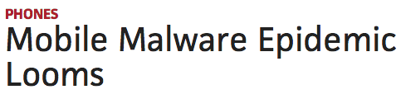
Mobile Malware
Notes:
Is mobile malware a problem?
List “news clippings” about current plague that is mobile malware (all from this year!)
Demonstrate that it looks like things are heading towards disaster

Slide 3
Malware Going Nuclear

Slide 4
Mobile Malware Research
Significant effort has been spent by researchers to characterize mobile applications and markets.
Market operators have invested significant resources in preventing malicious applications from being installed.
Extent to which mobile ecosystem is actually infected is still not well understood.
Use network level analysis to better
understand the threat.
Notes:
Discuss efforts have been largely focused on application analysis
- Use range of static and dynamic analysis techniques to discover malicious code
Discuss market approval and scanning processes (e.g., iOS and Google)
- iOS developers submit application for market approval.
- Google has developed “Bouncer” to scan submitted apps.
How many of you have been infected by mobile malware?
How many of you know someone infected by mobile malware?

Slide 5
Data Collection
Cell
Wired
Use passive DNS (pDNS) data collected at the recursive DNS (RDNS) level.
Data collected from a major US cellular provider and a large traditional, non-cellular ISP.
Notes:
Use cellular pDNS data collected from major US cellular provider.
- Data collected below the recursive (get device level information)
- Single sensor aggregating data from several cities in US
- 3 Week Observation Period
Use the traditional, non-cellular (“wired”) ISP to evaluate infrastructure and provide historical context about domains.
- 15 month observation period
- 7 sensors located across the US

Slide 6
Characterizing Cellular Traffic
Classification of RR
Malicious
Benign
Unknown
Labeling of Devices
Non-Mobile
Mobile
Mix
Notes:
Multi-stage characterization process.
What is a Resource Record (RR)?
- “queried domain” or qname
- “host” or IP returned by RDNS in A-Record
Classify traffic by type (Benign, Malicious, Unknown)
- Benign uses whitelist of Top 750K from Alexa
- Malicious means domain associated with some sort of malicious evidence
- Unknown is anything not in first two categories
Label devices by type (Mobile, Non-mobile, Mix)
- Discuss how we perform the labeling (mobile indicators, mobile services, etc.)
- Discuss why there are non-mobile devices in our mobile ISP.

Slide 7
Cellular pDNS Data Summary
Week (2012) | Hours | RRs | Domains | Hosts | Devices (Avg)
4/15 - 4/21 | 168 | 8,553,155 | 8,040,141 | 2,070,189 | 22,469,561
5/13 – 5/19 | 168 | 9,240,372 | 8,711,704 | 2,168,266 | 24,223,108
6/17 – 6/23 | 168 | 8,660,555 | 8,109,536 | 2,050,168 | 21,932,245
Total (Unique) | 504 | 16,298,114 | 14,828,149 | 3,053,704 | 22,874,971
Week (2014) | Hours | RRs | Domains | Hosts | Devices (Avg)
11/01 – 11/07 | 168 | 178,752,268 | 158,214,788 | 18,673,671 | 132,152,348
11/08 – 11/14 | 168 | 185,125,832 | 163,740,910 | 21,179,148 | 152,832,654
11/15 – 11/21 | 168 | 188,458,108 | 166,929,111 | 18,617,397 | 159,200,303
11/22 – 11/28 | 168 | 183,678,777 | 162,213,521 | 8,963,386 | 160,788,608
11/29 – 11/30 | 48 | 60,706,045 | 53,244,354 | 5,768,628 | 137,285,304
Total (Unique) | 720 | 684,641,271 | 613,350,819 | 28,799,008 | 151,858,362
Notes:
Highlight that these numbers are aggregate over the observation periods
Discuss that we saw approximately 17-25M devices per day
Discuss total device count and how we only label ~80% as mobile
These number represent strict upper bounds due to inability to track devices across days.

Slide 8
Cellular pDNS Data Summary
Week (2012) | Hours | RRs | Domains | Hosts | Devices (Avg)
4/15 - 4/21 | 168 | 8,553,155 | 8,040,141 | 2,070,189 | 22,469,561
5/13 – 5/19 | 168 | 9,240,372 | 8,711,704 | 2,168,266 | 24,223,108
6/17 – 6/23 | 168 | 8,660,555 | 8,109,536 | 2,050,168 | 21,932,245
Total (Unique) | 504 | 16,298,114 | 14,828,149 | 3,053,704 | 22,874,971
Week (2014) | Hours | RRs | Domains | Hosts | Devices (Avg)
11/01 – 11/07 | 168 | 178,752,268 | 158,214,788 | 18,673,671 | 132,152,348
11/08 – 11/14 | 168 | 185,125,832 | 163,740,910 | 21,179,148 | 152,832,654
11/15 – 11/21 | 168 | 188,458,108 | 166,929,111 | 18,617,397 | 159,200,303
11/22 – 11/28 | 168 | 183,678,777 | 162,213,521 | 8,963,386 | 160,788,608
11/29 – 11/30 | 48 | 60,706,045 | 53,244,354 | 5,768,628 | 137,285,304
Total (Unique) | 720 | 684,641,271 | 613,350,819 | 28,799,008 | 151,858,362
Notes:
Highlight that these numbers are aggregate over the observation periods
Discuss that we saw approximately 17-25M devices per day
Discuss total device count and how we only label ~80% as mobile
These number represent strict upper bounds due to inability to track devices across days.

Slide 9
Hosting Infrastructure
Wired
Hosts
Mobile
Hosts
1.3%
Observed 2,762,453 unique hosts contacted by mobile devices.
Only 1.3% (35,522) of “mobile” hosts were not in the set of hosts contained by historical non-cellular pDNS data.
The mobile Internet is really just the Internet.
Notes:
Discuss use of wired hosts from large non-cellular ISP (represents infrastructure for non-cellular world)
About 3M total hosts… mobile devices contact about 2.7M unique hosts.
Very significant overlap between wired hosts and mobile hosts.

Slide 10
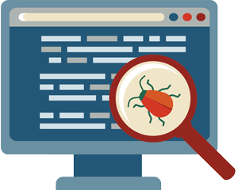
Evidence of Malware
Public Blacklist (PBL)
Phishing and Drive-by-Downloads (URL)
Desktop Malware Association (MAL)
Mobile Blacklist (MBL)
Notes:
PBL - Domain points to a host that can be found on aggregation of numerous PBLs.
URL - Domain points to a host historically known to facilitate phishing or drive-by download operations.
MAL - Domain points to a host historically associated with a piece of desktop malware.
MBL - Domain is associated with or known to facilitate mobile malware.

Slide 11
Observed Historical Evidence
Mobile Specific Evidence

Slide 12
Observed Historical Evidence
Desktop Related Evidence

Slide 13
Observed Historical Evidence (Redux)
Mobile Specific Evidence

Slide 14
Observed Historical Evidence (Redux)
Desktop Related Evidence

Slide 15



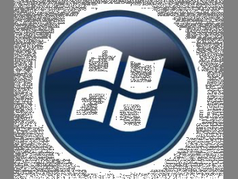
Tainted Hosts and Platforms
Platform | % Population requesting tainted hosts (2012) | % Population requesting tainted hosts (2014)
iOS
All other mobile (Android, etc.)
Notes:
What devices are connecting to “tainted” hosts (iOS, Android, Blackberry, Windows Phone, etc.)?
Separate out iOS devices because they are easy to detect at the DNS level due to Apple push notification domains.

Slide 16
Tainted Hosts and Platforms
Platform | % Population requesting tainted hosts (2012) | % Population requesting tainted hosts (2014)
iOS | 31.6%
All other mobile (Android, etc.) | 68.4%
Notes:
What devices are connecting to “tainted” hosts (iOS, Android, Blackberry, Windows Phone, etc.)?
Separate out iOS devices because they are easy to detect at the DNS level due to Apple push notification domains.

Slide 17
Tainted Hosts and Platforms
Platform | % Population requesting tainted hosts (2012) | % Population requesting tainted hosts (2014)
iOS | 31.6% | 38.9%
All other mobile (Android, etc.) | 68.4% | 61.1%
Notes:
What devices are connecting to “tainted” hosts (iOS, Android, Blackberry, Windows Phone, etc.)?
Separate out iOS devices because they are easy to detect at the DNS level due to Apple push notification domains.

Slide 18
Tainted Hosts and Platforms
Platform | % Population requesting tainted hosts (2012) | % Population requesting tainted hosts (2014)
iOS | 31.6% | 38.9%
All other mobile (Android, etc.) | 68.4% | 61.1%
Notes:
What devices are connecting to “tainted” hosts (iOS, Android, Blackberry, Windows Phone, etc.)?
Separate out iOS devices because they are easy to detect at the DNS level due to Apple push notification domains.

Slide 19
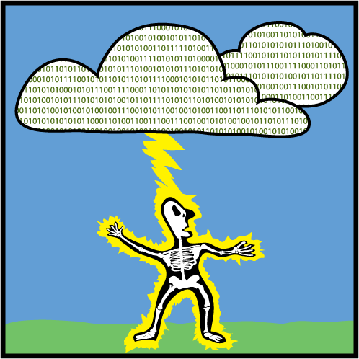
Mobile Malware in Numbers
Only 0.015% (3,492) out of a total of 23M mobile devices contacted MBL domains (observation period 2012).
Only 0.0064% (9,688) out of a total of 151M mobile devices contacted MBL domains (observation period 2014).
According to National Weather Service, odds of an individual being struck by lightning in a lifetime is 0.01% (1/10,000)!
Mobile malware is currently a real but small threat.
Notes:
Discuss the extremely small number of devices affected by currently known malware.
On the worst day in November, we saw 9,688 devices contacting MBL domains
On average, we saw about 8,757 devices contacting MBL domains
Since we can’t track across days, the absolute worse case scenario is 262,731 devices or 0.17%
To give perspective, how does risk of getting malware compare to getting struck by lightning?

Slide 20
Market and Malware (M&A) Dataset
Market Name | Market Country | Date of Snapshot | # Unique Apps | # Unique Domains | # Unique IPs
Google Play* | US | 09/20/11, 01/20/12 | 26,332 | 27,581 | 47,144
SoftAndroid | RU | 02/07/12 | 3,626 | 3,028 | 8,868
ProAndroid | CN | 02/02/12, 03/11/12 | 2,407 | 2,712 | 8,458
Anzhi | CN | 01/31/12 | 28,760 | 11,719 | 24,032
Ndoo | CN | 10/25/12, 02/03/12, 03/06/12 | 7,914 | 5,939 | 14,174
* Top 500 free applications per category only
Malware Dataset Name | Date of Snapshot | # Unique Apps | # Unique Domains | # Unique IPs
Contagio | 03/27/12 | 338 | 246 | 2,324
Zhou et al | 02/2012 | 596 | 281 | 2,413
M1 | 03/26/2012 | 1,485 | 839 | 5,540
Notes:
MOBILE MARKETS
Google Play (top 500 from each category)
4 other 3rd party markets
MALARE DATASETS
Contagio is community driven dump of malicious malware applications.
Zhou et Al is a collection of malware discovered at NC State
M1 dataset contains suspicious and confirmed malicious applications. Provided by an independent security company.

Slide 21
M&A Overlap with Wired pDNS
Wired
Hosts
M&A
Hosts
10%
At most 10% of M&A hosts are outside our non-cellular pDNS dataset.
More than 50% of M&A hosts are associated with at least seven domain names.
Mobile applications reusing same hosting infrastructure as
desktop applications.
Notes:
M&A Hosts is the set of hosts associated with directly extracted or associated with domains extracted from applications in the M&A dataset.
NOTE: In some markets, 100% of the hosts observed were in the historical wired pDNS datasets.

Slide 22
Lifecycle of a Threat
Threat ε
Point of Disclosure
October
Threat publicly disclosed by security community in October.
Associated domain no longer resolved at time of disclosure.
Notes:
Lookups for another domain associated with a different malicious threat ε using data from large authoritative DNS server.
Android application that masquerades as a legitimate client to a popular Internet streaming media service. Presents user with fake login prompt to steal credentials.
At time of disclosure, domain no longer resolved to routable address.

Slide 23
Network Behavior
Threat β
Mobile threats show high degree of network agility similar to traditional botnets.
Use of network based countermeasures may help
better detect and mitigate threats.
Notes:
How do we know this activity is actually malicious? It uses hosting infrastructure similar to traditional botnets.
Android application starts a service that periodically contacts C&C server. Responds to commands from C&C or via SMS. One command signs up all contacts for on-line mailing list. (SMS Trojan)
Figures show how the host pointed to by previously discussed mobile threats (ε and β) changed over time.

Slide 24
Summary of Observations
Mobile Internet is really just the Internet.
Mobile malware is still a real but small threat.
Mobile applications reusing same infrastructure as desktop applications.
Analysis of mobile malware slow to identify threats.
Network based countermeasures can and should be used.
Notes:
Hosting infrastructure used by mobile devices is part of core Internet infrastructure used by devices in non-cellular world.
Despite its tightly controlled market, iOS devices are no less likely than other major platforms to reach out to suspicious hosts.
Network based countermeasures may help identify and mitigate threats faster than current methods.
"The mobile Internet is really just the Internet." (seems obvious only in retrospect)
Mobile malware is "real and small" threat

Slide 25
Apply What You Have Learned Today
What you can do today:
  When downloading applications for your mobile device, try and stick to first-party application markets.
  Be mindful that certain threats like phishing can be more effective against mobile users due to limited screen real estate.
What you should be doing in the future:
  Leverage your existing network infrastructure to help identify mobile devices.
  Analyzing the network infrastructure mobile devices are contacting by using new or existing tools to evaluate the reputation of that infrastructure.

Slide 26
Questions?

Slide 27
References
The Core of the Matter: Analyzing Malicious Traffic in Cellular Carriers,
Network & Distributed System Security Symposium (NDSS), 2013
Mobile Malware Sources (Public)
  Contagio Mobile Malware (http://contagiominidump.blogspot.com)
  Android Malware Genome (http://www.malgenomeproject.org)
  VirusTotal (https://www.virustotal.com)

