Slide 1
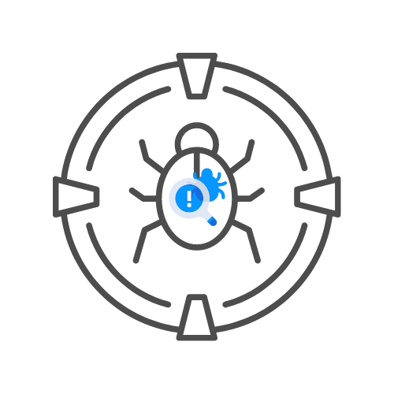

API Hacking With the OWASP Top 10
⌛ 15 min
DAY 07

Slide 2
0. What is an API?
- API – Application Programming Interface
- API Architectures
- REST
-- Representational State Transfer
-- SOAP
--- Protocol , not architecture
--- Simple Object Access Protocol
- Public VS Private APIs VS Partner APIs VS Mixed

Slide 3
API1:2019 Broken Object Level Authorization
- Object is required
- Broken authentication
- Usually marked by identifier
- Traditional IDOR
– Based on userID or ObjectID
- I.e. UserID can access object or object ID can be accessed
- https://hackxpert.com/API-testing.php?lab=a1

Slide 4
API1:2019 Broken Object Level Authorization
- Object is required
- Broken authentication
- Usually marked by identifier
- Traditional IDOR
– Based on userID or ObjectID
- I.e. UserID can access object or object ID can be accessed
- https://hackxpert.com/API-testing.php?lab=a1

Slide 5
API2:2019 Broken User Authentication
- If your API allows for credential stuffing.
- If the API endoint does not verify the request with a captcha when needed
- When the application allows for weak passwords.
- When the endpoint uses GET parameters (parameters in the URL) to send sensitive data such as passwords or tokens
- When our endpoint issues a token such as JWT but does not validate it.
- When we use JWT, we should be aware that we should not accept unsigned or weakly signed tokens.
- When the endpoint does not validate the expiration date of authentication tokens such as session tokens or JWT
https://hackxpert.com/API-testing.php?lab=a2

Slide 6
API3:2019 Excessive Data Exposure
- API is only supposed to return the required data to the front-end clients
- sometimes developers will make a mistake or take the easy route and implement generic API's that return all data to the client
- When these API's return too much data ➔ Excessive Data Exposure
- For example:
-- API returns password even though front end does not show it
-- Or full credit card details
-- Or full personal details while masked in the application
-- ...
- https://hackxpert.com/API-testing.php?lab=a3

Slide 7
API4:2019 Lack of rate limiting
- Resources are used for every request
- Too many requests, too many resources = issues
- Also not stopping others from abusing credential stuffing or brute forcing
- Present in all the labs before

Slide 8
API5:2019 Broken Function Level Authorization
- quite complex and varied
- Predictable endpoint naming
- Hidden endpoints + access control = API5
- Also parameters and even subdomains
- Also includes request methods
- https://hackxpert.com/API-testing.php?lab=a5

Slide 9
API6:2019 Mass Assignment
- Objects have properties
- Sometimes we can edit these properties
- Some properties might not be in the application
- We can still predict them and maybe even edit them
-- Account.AccountType or Account.discountsEnable. These are properties that relate to permissions.
-- Account.wallet This property should never be editable be the attacker
-- product.title These are internal properties the user should never be able to edit

Slide 10
API7:2019 Security Misconfiguration
- Several factors depending on
-- The architecture
-- The programming language
-- The modules and 3rd party integrations
-- The business requirements
- You have to weigh of security configuration vs user friendliness
- All the labs have it, debug console is still on

Slide 11
API8:2019 Injection
- Not sanitizing input
- Many different types
- LDAP, HTML, Log, XSS (script injection), SQLi, NoSQLi, XPATH,...
- https://hackxpert.com/API-testing.php?lab=a2

Slide 12
API9:2019 Improper Assets Management
- Use an inventory management system
- Keep track of APIs and versions
- Make sure dev APIs do not go to PROD
- Everything should be documented
- Prevent shadow APIs

Slide 13
API10:2019 Insufficient Logging & Monitoring
- Log and monitor important flows
- Should be able to audit any important flow
- If under attack, alerts should go off
- Ask your client, test this!

