Slide 1
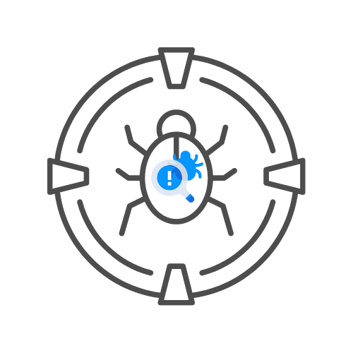

OWASP top 10
⌛ 15 min
DAY 06

Slide 2
Agenda
A01:2021-Broken Access Control
A02:2021-Cryptographic Failures
A03:2021-Injection
A04:2021-Insecure Design
A05:2021-Security Misconfiguration
A06:2021-Vulnerable and Outdated Components
A07:2021-Identification and Authentication Failures
A08:2021-Software and Data Integrity Failures
A09:2021-Security Logging and Monitoring Failures
A10:2021-Server-Side Request Forgery

Slide 3
A01:2021-Broken Access Control
Vertical or horizontal
IDOR also part ofF
Copy and paste requests
Copy and paste js functions
autohorize

Slide 4
A01:2021-Broken Access Control
GET vs POST vs cookies vs headers IDOR
objectID or userID based
Secondary vs primary IDOR
Inter-company IDOR vs Inner company IDOR
normal number vs UUID vs hashed values
Impact
Destruction of data on DELETE call
Update or insertion of data in POST call
Update of data in PUT call
Getting data in GET call

Slide 5
Labs: BAC
15 min
Find the IDOR in https://hackxpert.com/cheesebook/index.php
There are 3

Slide 6
A02:2021-Cryptographic Failures
Weak algorithms
Data sent over plain text
HTTPs should be enforced
Key being stored incorrectly
…

Slide 7
Labs: Cryptographic failures
15 min
Find the cryptographic failures in https://hackxpert.com/LABS/JWT
There are 3

Slide 8
A03:2021-Injection
Can be any type of inections
HTML
JS
CSS
Header
LDAP
Logging
CLRF
…
Caused by improperly validated user input

Slide 9
A03:2021-Injection
XSS: ‘”><img src=x>
HTML injection: <img src=x>
CSTI: ${{7*7}}
SQLi: ‘”`
Combined: ‘”`><img src=x>

Slide 10
Labs: Injections
15 min
Find the Injection failures in https://hackxpert.com/labs/csti
https://hackxpert.com/labs/RXSS/GET/
Find HTML inject in 01.php
Find HTML tag injection in ??.php
Find JS injection in ??.php

Slide 11
A04:2021-Insecure Design
New for 2021
Scenario #1: A credential recovery workflow might include “questions and answers,” which is prohibited by NIST 800-63b, the OWASP ASVS, and the OWASP Top 10. Questions and answers cannot be trusted as evidence of identity as more than one person can know the answers, which is why they are prohibited. Such code should be removed and replaced with a more secure design.

Slide 12
A04:2021-Insecure Design
Scenario #2: A cinema chain allows group booking discounts and has a maximum of fifteen attendees before requiring a deposit. Attackers could threat model this flow and test if they could book six hundred seats and all cinemas at once in a few requests, causing a massive loss of income.
Scenario #3: A retail chain’s e-commerce website does not have protection against bots run by scalpers buying high-end video cards to resell auction websites. This creates terrible publicity for the video card makers and retail chain owners and enduring bad blood with enthusiasts who cannot obtain these cards at any price. Careful anti-bot design and domain logic rules, such as purchases made within a few seconds of availability, might identify inauthentic purchases and rejected such transactions.

Slide 13
Labs: Insecure design
Take 15 minutes to identify the design flaws in https://hackxpert.com/webshop/
There are at least 3
Do you notice how similar it is to business logic flaws in our example? That is because issues can often overlap in belonging to a category.

Slide 14
A05:2021-Security Misconfiguration
Can happen in many ways
HTTP only flag not set
Too many ports open
Default accounts
Stack traces are enabled
Debug mode is enabled…

Slide 15
Labs: Use nmap to find misconfigs
Take 15 minutes to identify security misconfigurations on hackxpert.com
Use nmap
Use nikto
Seperatly from the tools, Try to find default accounts on the websites hackxpert.com/pentest and hackxpert.com/cheesebook
Test/test
Admin/test
Admin/admin
…

Slide 16
A06:2021-Vulnerable and Outdated Components
Not only libraries but also includes of libraries
Example log4j >> You might not use vulnerable version but a library you use might

Slide 17
LABS: Vulnerable and Outdated Components
Take 10 minutes to identify the vulnerable components in
https://hackxpert.com/labs/CSTI/
Take 20 minutes to identify and exploit the vulnerable component on hackxpert.com/ratsite

Slide 18
A07:2021-Identification and Authentication Failures
Permits automated attacks such as credential stuffing, where the attacker has a list of valid usernames and passwords.
Permits brute force or other automated attacks.
Permits default, weak, or well-known passwords, such as "Password1" or "admin/admin".
Uses weak or ineffective credential recovery and forgot-password processes, such as "knowledge-based answers," which cannot be made safe.

Slide 19
A07:2021-Identification and Authentication Failures
Uses plain text, encrypted, or weakly hashed passwords data stores (see A02:2021-Cryptographic Failures).
Has missing or ineffective multi-factor authentication.
Exposes session identifier in the URL.
Reuse session identifier after successful login.
Does not correctly invalidate Session IDs. User sessions or authentication tokens (mainly single sign-on (SSO) tokens) aren't properly invalidated during logout or a period of inactivity.

Slide 20
LABS Identification and Authentication failures
Take 10 minutes to identify the issue in
  https://hackxpert.com/labs/ratsite
It should have an issue with the password

Slide 21
A08 Software and Data Integrity Failures
We trust software or data from external sources
  Cookies
  Serialised data
  External software
This needs verification for data integrity

Slide 22
A09 Security Logging and Monitoring Failures
Monitoring is important
Alerting is just as important
Hackxpert.com is logged but not monitored properly yet

Slide 23
A10 Server Side Request Forgery (SSRF)
See SSRF slides

