Slide 1
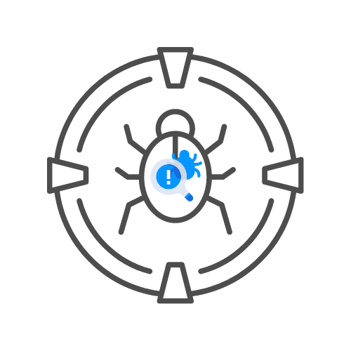

USE AN OUT OF BAND SERVER
⌛ 15 min
L A B 🧪
DAY 07

Slide 2
LABS: OOB SERVERS🧪
⚙️SET UP A WEBHOOK.SITE
⚙️TEST HTTPS://HACKXPERT.COM/LABS/SSRF/
⚙️CAN YOU GET THE SECRET INTERNAL DIRECTORY?

