Slide 1
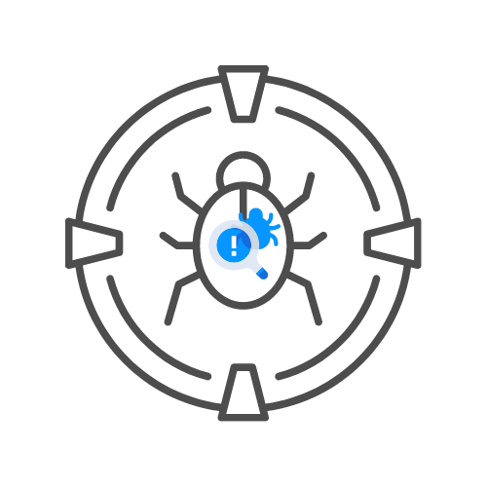

OUT OF BAND SERVERS
⌛ 45 min
DAY 07

Slide 2
Agenda
WHAT IS IT?
WHY?
BURP SUITE COLLBORATOR
INTERACT.SH
WEBHOOK.SITE

Slide 3
WHAT IS IT?
SIMPLE WEBSERVER YOU CAN SEND REQUESTS
USED TO SMUGGLE OUT DATA
DNS,HTTP, EMAIL, …
GET REQUEST
PARAMETERS BEING DATA

Slide 4
WHAT IS IT?
ATTACKERS-SERVER.COM/GRAB.PHP?COOKIE=…
CHECK THE ACCESS LOGS
BOOM, OUT OF BAND SERVER

Slide 5
WHy ?
💠WE MIGHT NEED TO TEST OUT OF BAND INTERACTIONS SUCH AS SSRF

Slide 6
BURP SUITE COLLABORATOR
FREE VERSION EXISTS
⭕PUBLIC SO BUGGY
PAID VERSION IS PRIVATE
⭕400$ A YEAR ATM
REALLY GOOD OUT OF BAND SERVER

Slide 7
INTERACT.SH
DNS/HTTP(S)/SMTP(S)/LDAP INTERACTION SUPPORT
NTLM/SMB/FTP/RESPONDER LISTENER SUPPORT (SELF-HOSTED)
WILDCARD INTERACTION SUPPORT (SELF-HOSTED)
CLI / WEB / BURP / ZAP / DOCKER CLIENT SUPPORT
SELF HOSTED INTERACTSH SERVER SUPPORT
AES ENCRYPTION WITH ZERO LOGGING
AUTOMATIC ACME BASED WILDCARD TLS W/ AUTO RENEWAL
DNS ENTRIES FOR CLOUD METADATA SERVICE

Slide 8
INTERACT.SH
💠HTTPS://GITHUB.COM/PROJECTDISCOVERY/INTERACTSH

Slide 9
WEBHOOK.SITE
UNIQUE RANDOM URL
WEBHOOK AND HTTP REQUESTS
CREATE YOUR OWN WORKFLOWS

Slide 10
SSRF
SERVER-SIDE REQUEST FORGERY
MAKE THE SERVER DO A REQUEST FOR US
GIVES US ACCES TO INTERNAL NETWORKS

