Slide 1
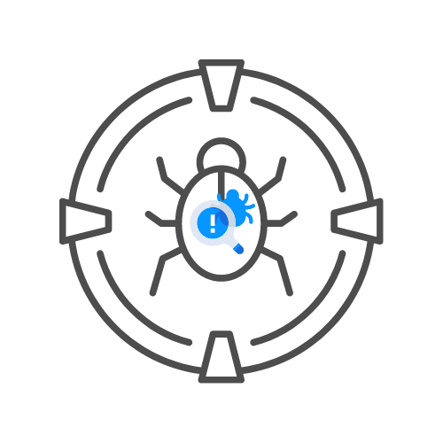

VULNERABILITY SCANNERS🔍
⌛ 15 min
ASSIGNMENT
DAY 07

Slide 2
Assignment 🧪
⚙️SCAN HACKXPERT.COM/LABS WITH THE NUCLEI COMMUNITY TEMPLATES
⚙️HOW MUCH VULNERABILITIES DID YOU FIND?

