Slide 1
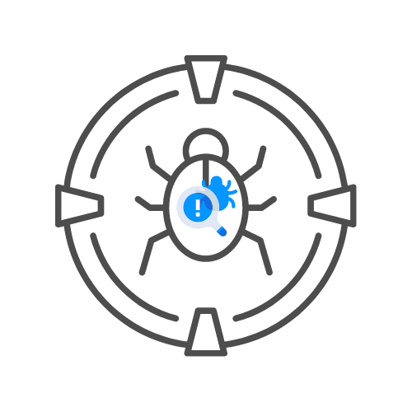

POSTMAN DEMO
⌛ 30 min
UNCLE RAT GIVES A DEMO
DAY 07

