Slide 1
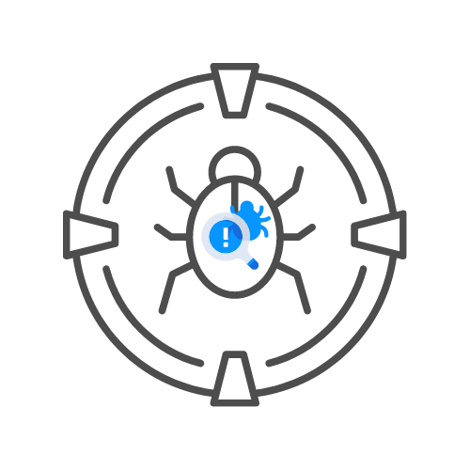
Network hacking methdology Pt.2
⌛ 60 min
BY UNCLE RAT aka THE XSS RAT
DAY 05

Slide 2
DNS Poisoning
Poisoning the DNS cache to reroute requests
Attacker inserts a false DNS entry pointing a legitimate request to their malicious site
Widely used attack, but must have access to the dns server that the victim would hit
Makes it so the user does not need to click a phishing link, they could make a normal request, and be redirected to the attackers site.
Banner enum on ports
See if vulnerable version of software runs on port
Tools: ettercap, normal dns access, etc.

Slide 3
ARP POisoning (AKA ARP SPoofing)
Floods the LAN with spoofed ARP requests, so that it poisons the arp cache
Usually used to force the victims machine to log the attackers MAC address to the IP of another machine on the LAN, typically the default gateway
Man in the middle attacks use this method, positioning you in the middle of the victim and the gateway, telling the gateway you are the victim, and telling the victim you are the gateway.
If done improperly, can cause havoc on the LAN
Tools: Ettercap, Bettercap, Cain and Abel

Slide 4
VLAN Hopping
What's a VLAN
Double Tagging- Adding 2 frames, one to trunk, the second to tell the next hop which VLAN to send it through
Switch Spoofing - Using DTP packets to act as a switch on the network, getting access to all vlans

Slide 5
Next steps

Slide 6
Packet Capture
Why capture packets?
Promiscuous mode
Location of the capture matters
Use Filters to only capture what you need
Learning how to read the packets to tell a story
Tools to fit the job:

Slide 7
Packet Capture
Tools:
  Wireshark - https://www.wireshark.org/
  Tcpdump - https://www.tcpdump.org/
  Solarwinds Deep Packet Analysis Tool
Location of the capture matters
Use Filters to only capture what you need
Lets download Wireshark!!

