Slide 1
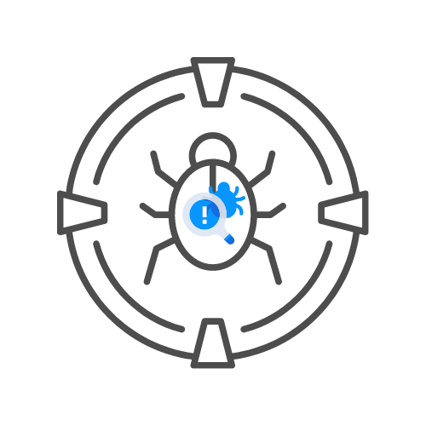
Business logic flaws
⌛ 30 min
By Uncle RAT 🐀
DAY 05

Slide 2
Agenda
What is it
Impact
Examples

Slide 3
What is it ?

Slide 4
WHAT IS it?
Flawed assumptions about user behavior
Leads to flaws in the design and implementation of the logic
Will not be exposed by normal use of the application
Are normally invisible
By passing unexpected values to the server we try to induce unwanted behavior

Slide 5
Impact

Slide 6
Impact
Can range from trivial to critical
Depends on the related functionality
I.e. flawed logic in money transactions is much more impactfull than
flawed logic signing up for a newsletter

Slide 7
Examples

Slide 8
Examples
The best way is to learn by example
https://portswigger.net/web-security/logic-flaws/examples
🎯Client side calculations of prices in a webshop
🎯Existing users return another status code from non-existing ones when user brute forcing
🎯Negative amounts of items on a webshop lead to negative prices
🎯If price = integer and amount = integer and total price = interger we can overflow total price when we price * amount
🎯Very very long input might get cut off allowing for unintended behaviour when
registering an account

