Slide 1
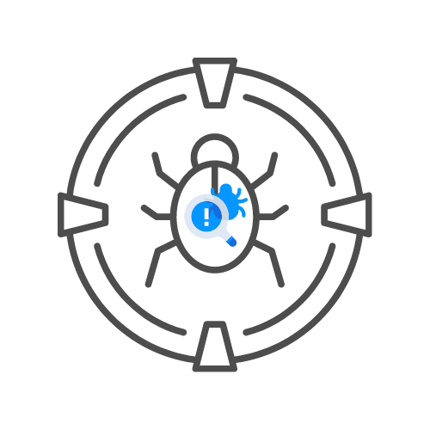
IDOR LABS
⌛ 60 min
BY UNCLE RAT aka THE XSS RAT
DAY 05

Slide 2
DEMO: AUTHORIZE
GIVE A DEMO ON AUTH0RORIZE

Slide 3
IDOR AND BAC LABS
USE BURP SUITE TO TEST FOR IDORS IN
🧊HTTPS://HACKXPERT.COM/RATSITE
USE OWASP ZAP TO TEST FOR BAC ON
🧊HTTPS://HACKXPERT.COM/PENTEST/

