Slide 1
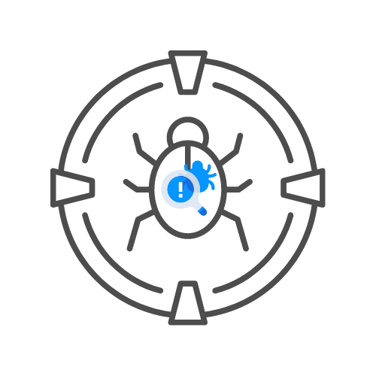
CAPTCHA LABS
⌛ 10 min
Assignment
DAY 05

Slide 2
Captcha labs
SOLVE LABS WITH
🎯PORTSWIGGER BURP SUITE
🎯OWASP ZAP
🎯BROWSER

