Slide 1
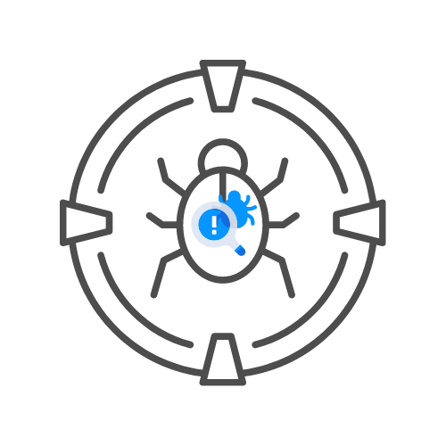
ASSIGNMENT
⌛30 min
CSRF LABS
DAY 04

Slide 2
ASSIGNMENT: 15 MIN
🎯FIND THE CSRF ISSUES ON https://hackxpert.com/labs/CSRF
TEST FOR
🧊CHECK IF THE TOKEN IS PRESENT ON ANY FORM IT SHOULD BE
🧊SERVER CHECKS IF THE TOKEN LENGTH IS CORRECT
🧊SERVER CHECKS IF PARAMETER IS THERE
🧊SERVER ACCEPTS EMPTY PARAMETER
🧊SERVER ACCEPTS RESPONDS WITHOUT CSRF TOKEN
🧊TOKEN IS NOT SESSION BOUND

