Slide 1
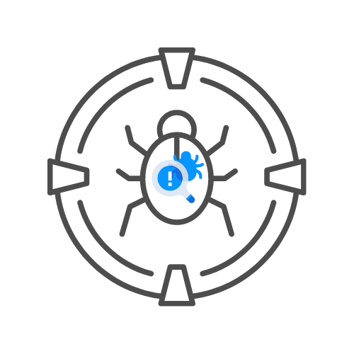
CSRF
⌛ 20 min
Build It Yourself
DAY 04

Slide 2
aGENDA
Introduction
Make a connection
Let's create a CSRF
Let's hack it
Let's secure it
🧊Step 1: Generate the token
🧊Now add the token to the form
Try to hack it
So what is the solution?
Tips
Resources

Slide 3
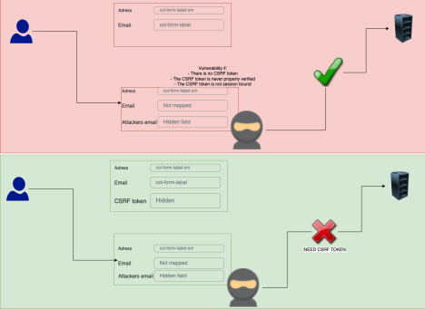
🧊Introduction
In this practical guide, you will be building a banking application. You are creating the money transfer form and it has a recipient and amount field. This is very oversimplified and in most cases, you will notice banks add extra security measures such as requiring the user to re-enter their password when making a transaction and the use of MFA
(Multi-factor authentication).
In our example, an attacker will be able to emulate the form on his own website first before we try to put a stop to it.

Slide 4
Make a connection
🎯FTP connection: hackxpert.com
🧊User: Training
🧊Password: test
🎯Create a new file on the server
📌 Use “nickname.php” for example “rat.php” where the nickname can be anything, as long as you can copy and paste it
⚠️🚨THE SERVER GETS ERASED EVERY 24 HOURS

Slide 5
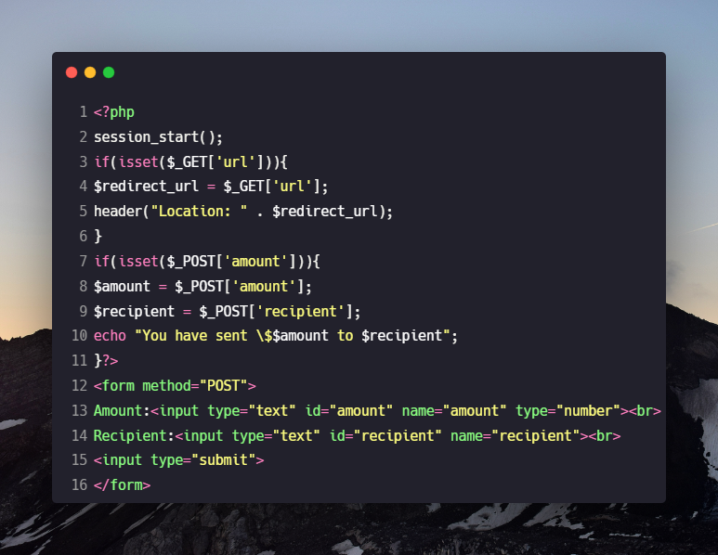
🧊Let's create a CSRF
📌Enter the following code in your file and upload it to the server.

Slide 6

Let’s hack it
Now we are going to surf to our page at hackxpert.com/Training/YOURFILE.php and try to create a CSRF PoC. There are several tools such as burp suite pro's CSRF PoC creator but for the free option I always prefer:
🎯https://security.love/CSRF-PoC-Genorator/
We know it's a POST request from the part:
<form action=YOUR_FILE.php method="POST">
so that should be the easy part

Slide 7
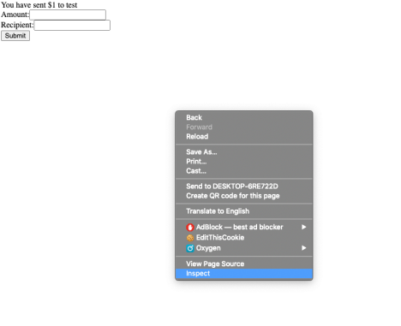
🧊 The rest we can figure out in the developer console, so go to inspect the page:
📌Go to the network tab and submit the form again but only after going to the network tab because otherwise you request will not be captured.
📌Here in the "request header" section, you can find the content type

Slide 8
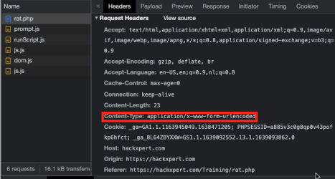
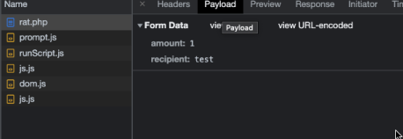
📌And in the payload tab we can find the parameters we need.
📌Let's fill these in but remember that in our tool, we need to enter parameter=value not parameter:value like
chrome is displaying here.

Slide 9
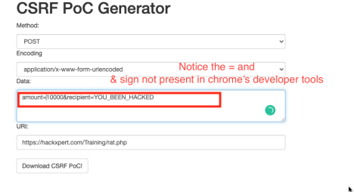
📌The URI is simply the value of where the original page resides that the attacker wants to emulate
📌Now download the PoC, open it from our PC or webserver, click the button and you should see on your training file that a transfer was executed that came from an attacker.

Slide 10
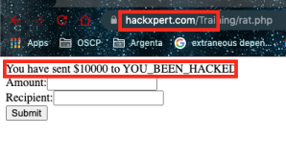

📌Now let's make it even spookier, since you have that HTML file for the PoC anyway, try to hide the input fields and simply display a text like "click here to win a million $$$"

Slide 11
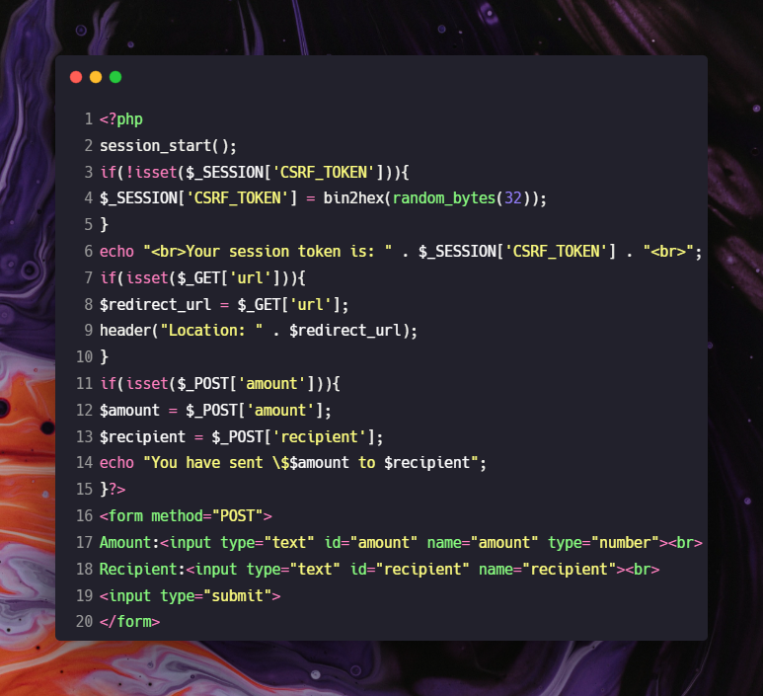
let’s secure it
🎯 Step 1: Generate the token

Slide 12
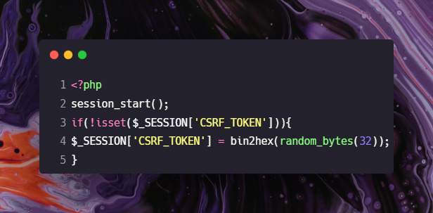
🎯Now add the token to the form
📌We usually add these tokens in a hidden field so let's do that here as well:

Slide 13
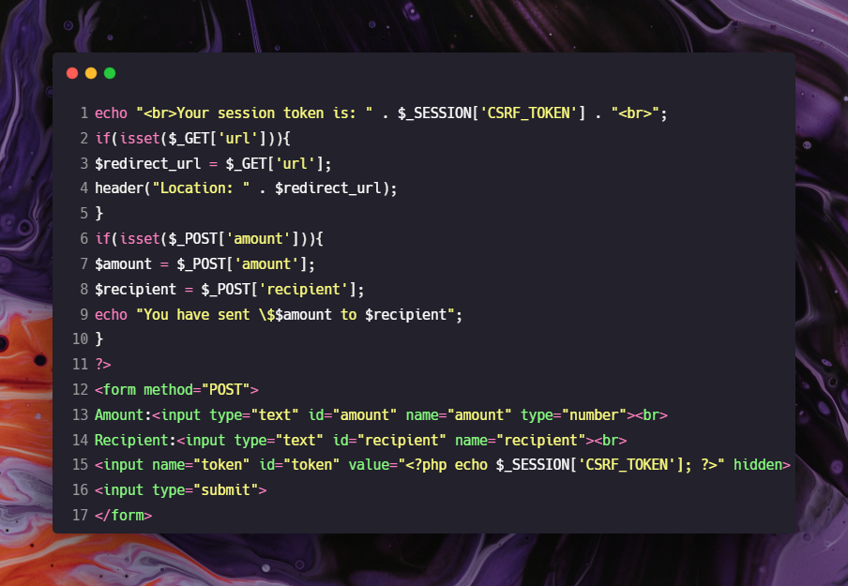

📌Here you can see a new field:
Which will contain our token when the PHP page is rendered.
<input name="token" id="token" value="<?php echo $_SESSION['CSRF_TOKEN']; ?>"
hidden>

Slide 14
🧑‍💻Try to hack it
So now that we have a CSRF token, it should be secure right?
Try the same method of hacking the system as we tried before with the PoC generator. It works right? Why?
🧑‍💻 So what is the solution?
Of course, you still need to check if the CSRF token is valid so change the code as follows:

Slide 15
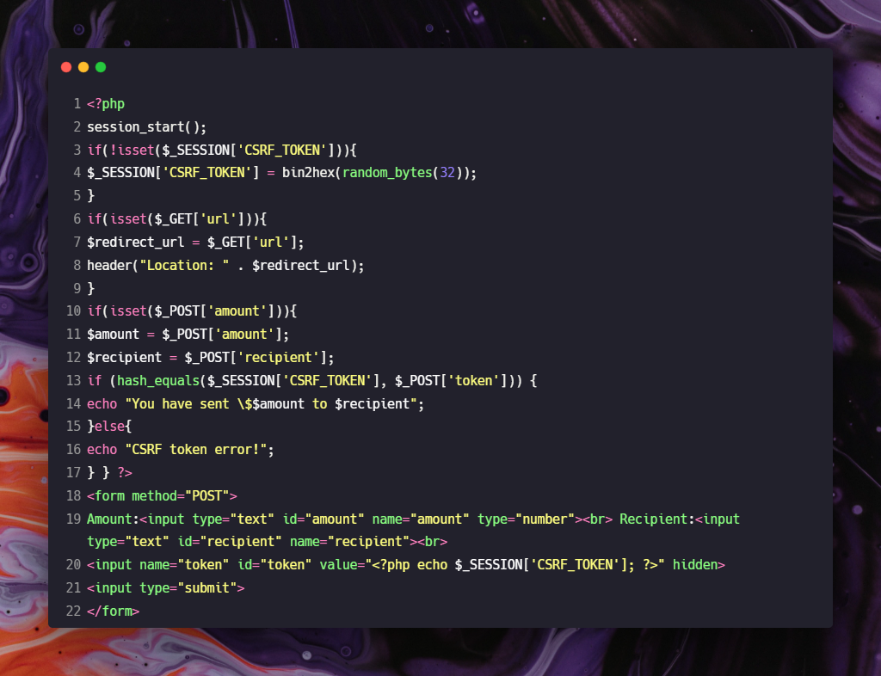
📌You can notice the new IF clause around the action of making a transaction. This is proper CSRF protection but things can still go wrong, this is why I urge you to look at the tips.

Slide 16
TIPS
CSRF can go wrong if there is no token where one is needed, this is the most
overlooked issue because testing existing things is easy but realizing something is
not there when it should be is hard. Use automated tooling to check all the forms
with creating, update or delete actions except for registration forms and things
where a user is not logged in yet.
Use a hash comperating function because a normal comperator (such as == ) might
open you up to type mismatching attacks
Always use 1 central CSRF generator and validator you include in all pages
Check the full parameter and not just part of it

Slide 17
Resources
https://security.love/CSRF-PoC-Genorator/
https://portswigger.net/burp/documentation/desktop/functions/generate-csrf-poc
https://owasp.org/www-community/attacks/csrf
https://cheatsheetseries.owasp.org/cheatsheets/Cross-
Site_Request_Forgery_Prevention_Cheat_Sheet.html

