Slide 1
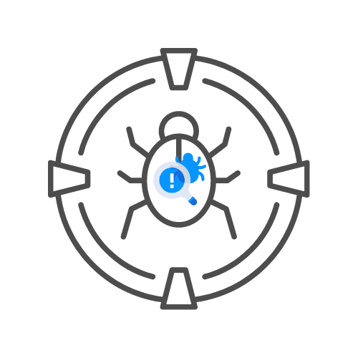
NETWORK PENTESTING – FTP
⌛ 15 min
DAY 03

Slide 2
agenda
BASIC CONNECTION
HELP AND FEAT COMMANDS
ANONYMOUS LOGIN
BRUTE FORCING VIA FTP SCRIPTS NMAP
FTP COMMANDS YOU HAVE TO KNOW

Slide 3
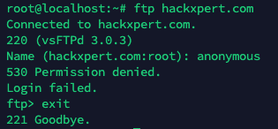
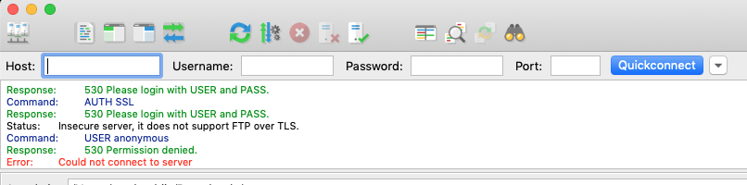
🎯BASIC CONNECTION

Slide 4
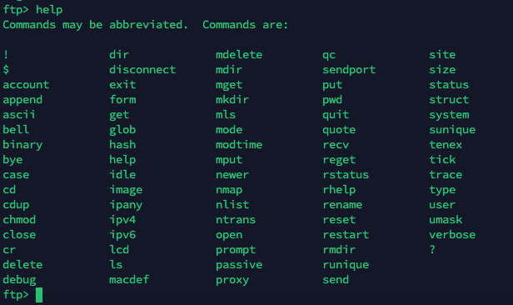
🎯Ftp help

Slide 5
🎯ANONYMOUS LOGIN

Slide 6




📌IMPORTANT COMMANDS
PUT – UPLOAD A FILE
GET – DOWNLOADS A FILE
CD – CHANGE WORKING DIRECTORY
DIR – SHOW THE FILES IN CURRENT DIRECTORY

