Slide 1

NETWORK PENTESTING-PORTSCAN
⌛ 15 min
KNOCK KNOCK, IS YOUR PORT OPEN 🤔?
DAY 03

Slide 2
agenda
NMAP
NMAP ALL THE PORTS
MASSCAN
SYN-FIN-ACK

Slide 3
Nmap
$ nmap hackxpert.com
-sc
🧊DEFAULT SCRIPTS
-sv
🧊BANNER ENUMERATION
-t4
🧊-T<0-5>: SET TIMING TEMPLATE (HIGHER IS FASTER)
-oa
🧊OUTPUT IN ALL FORMATS

Slide 4
Nmap All the ports
$ nmap hackxpert.com
-p-
🧊ALL THE PORTS
-P0,1000
🧊PORT 0 TO 1000
-u
🧊UDP PORTS AS WELL

Slide 5
Nmap All the ports
📌masscan
MUCH FASTER THAN NMAP
YOU HAVE TO SPECIFY ALL THE PORTS YOU WANT TO SCAN
TEDIOUS WORK
CAN’T DO DEFAULT SCRIPTS
USUALLY OUTPUT IS FED INTO NMAP
USED TO SCAN MULTIPLE HOSTS AT ONCE
SCANS NETWORK RANGE /8 FOR EXAMPLE

Slide 6
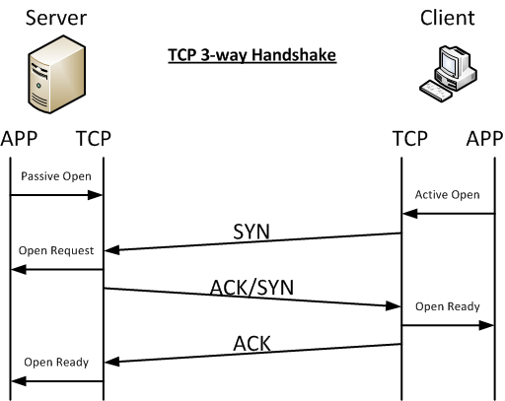
SYN – FIN – ACK
🎯NMAP CAN DO SYN SCAN AS WELL
🎯IT WON’T COMPLETE HANDSHAKE
🎯LOOKS LESS SUS
🎯-SS

