Slide 1
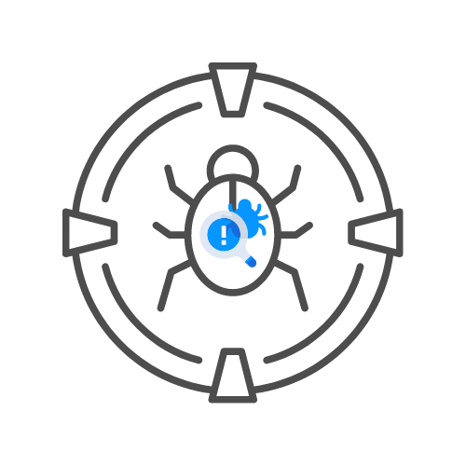
ASSIGNMENT
⌛30 min
NETWORK PENTESTING LABS
DAY 03

Slide 2
ASSIGNMENT: 15 MIN
LABS
🧊DNMAP SCAN OF HACXPERT
🧊NIKTO SCAN OF HACKXPERT
🧊DOWNLOAD AND RUN XRAY ON HACKXPERT.COM
🧊DOWN AND RUN XRAY AS A PROXY
🧊JOHN THE RIPPER ON YOUR OWN /ETC/PASSWD OR /ECT/SHADOW FILE – 🧊CAN YOU BE HACKED?
▶️WHAT PASSWORD LIST ARE YOU USING?

