Slide 1
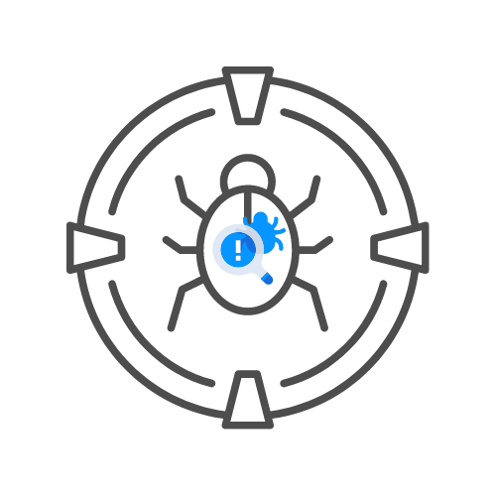
OSTMM
⌛ 60 min
THE OPEN SOURCE SECURITY TESTING METHODOLOGY MANUAL
DAY 02

Slide 2
AGENDA
WHAT YOU NEED TO KNOW
SECURITY ANALYSIS
OPERATIONAL SECURITY METRICS
TRUST ANALYSIS
THE WORKFLOW

Slide 3
WHAT YOU NEED TO KNOW ?

Slide 4
What you need to know
ALL ABOUT OPSEC
MOVE ASSET AS FAR FROM THREAT AS POSSIBLE
NEUTRALISE THREAT (BY INPUT SANITISATION I.E.)
DESTROY THE THREAT
100% SECURITY IS POSSIBLE IF WE CAN COVER THAT THE THREAD AND ASSET ARE SEPERATED
📌IN PRACTICE, NEARLY IMPOSSIBLE.

Slide 5
What you need to know
CONTACT BETWEEN ASSET AND OUTSIDE WORLD SOMETIMES REQUIRED
EVERY ENTRY ENTRY POINT INCREASES “POROSITY”
MORE ”POROSITY” = LESS SECURITY
A “PORE” CAN BE “VISIBILITY” , “ACCESS” OR “TRUST”
THE ASSETS CAN BE ACCESS THROUGH PORES WITH VARIOUS CONTROLS

Slide 6
12 10 CONTROLS
WE LOST 2 ALONG THE WAY

Slide 7
12 10 CONTROLS - INTERACTIVE
AUTHENTICATION
INDEMNIFICATION
A ”CONTRACT” ENFORCED BETWEEN ASSET AND THE INTERACTING PARTIES
RESILIENCE
SUBJUGATION
ASSURES INTERACTIONS CAN ONLY OCCUR ACCORDING TO DEFINED PROCESS
CONTINUITY

Slide 8
12 10 CONTROLS - INTERACTIVE
AUTHENTICATION
INDEMNIFICATION
A ”CONTRACT” ENFORCED BETWEEN ASSET AND THE INTERACTING PARTIES
RESILIENCE
SUBJUGATION
ASSURES INTERACTIONS CAN ONLY OCCUR ACCORDING TO DEFINED PROCESS
CONTINUITY

Slide 9
OBJECTIVES VS CONTROLS
WHAT TO DO WHEN AND WHY

Slide 10
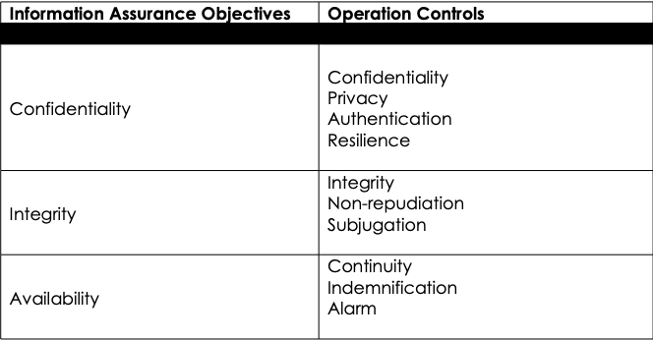
OBJECTIVES VS CONTROLS

Slide 11
LIMITATION
LET’S ADD ANOTHER LAYER

Slide 12
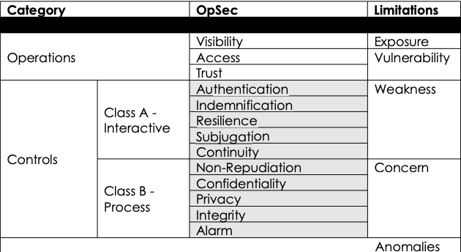
limitations

Slide 13
THE METHODOLOGY
BRINGING IT ALL TOGETHER

Slide 14
THE METHODOLOGY
FOR EVERY CONTACT POINT OF ASSET WITH OUTSIDE ACTOR
🧊 FOR EVERY HOLE
🧊 APPLY AT MAX. 10 CONTROLS
🧊 TO COVER 4 LIMITATIONS
🧊 AND BRING SECURITY BACK UP TO 100%
APPLIES TO A SNAPSHOT AND NEEDS TO BE RE-EVALUATED REGULARLY

Slide 15
WHAT YOU HAVE TO DO
COVERING THE COVERAGE

Slide 16
DEFINE A SECURITY TEst
📌7 STEPS FOR EVERY SECURITY TEST
🧊DEFINE YOUR ASSETS, CONTROLS AND LIMITATIONS
🧊DEFINE AREAS AROUND THE ASSET, THIS IS THE ENGAGEMENT ZONE
🧊DEFINE EVERYTHING AROUND ENGAGEMENT ZONE, THIS IS SCOPE
🧊DEFINE THE INTERACTION OF THE SCOPE WITH THE WORLD, THIS IS THE VECTORS
🧊DEFINE EQUIPMENT REQUIRED, THESE ARE THE CHANNELS
🧊DEFINE TEST TYPE
🧊DEFINE RULES OF ENGAGEMENT

Slide 17
scope
👉 TOTAL POSSIBLE OPERATING SECURITY ENVIRONMENT
🧊 FOR ANY INTERACTION WITH ANY ASSET
🧊 MAY INCLUDE THE PHYSICAL COMPONENTS OF SECURITY MEASURES AS WELL.

Slide 18
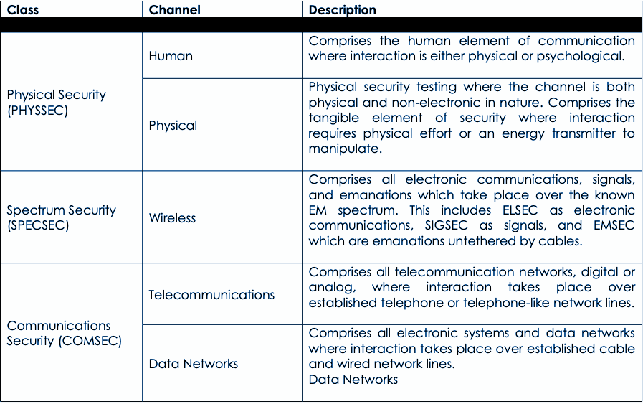
CHANNELS

Slide 19
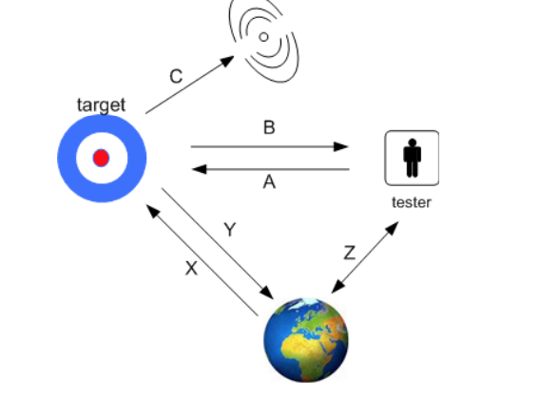
4 POINT PROCESS
INDUCTION (Z)
🧊UNDERSTANDING WHERE THE
TARGET RESIDES AND FROM WHERE.
INQUEST (C)
INTERACTION (A/B <> B/A)
INTERVENTION (X/Y/Z)

Slide 20
TRIFECTA
HOW DO CURRENT OPERATIONS WORK?
HOW DO THEY WORK DIFFERENTLY FROM HOW MANAGEMENT THINKS THEY WORK?
HOW DO THEY NEED TO WORK?

Slide 21
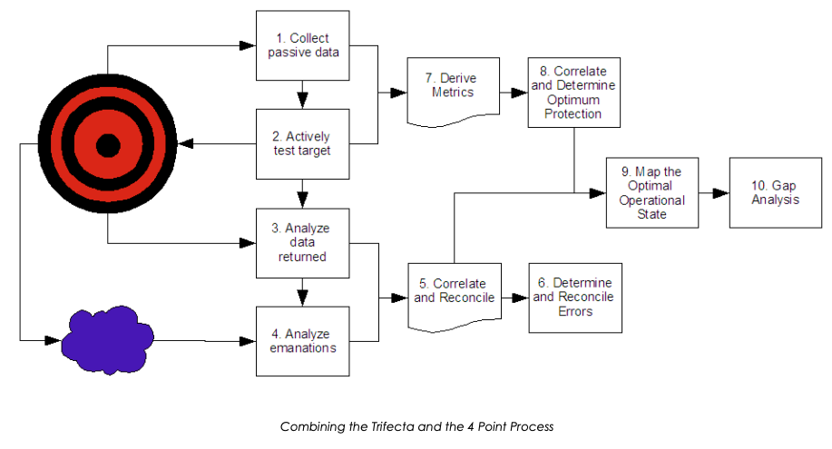

Slide 22
Test results
1. DATE AND TIME OF TEST
2. DURATION OF TEST
3. NAMES OF RESPONSIBLE ANALYSTS
4. TEST TYPE
5. SCOPE OF TEST
6. INDEX (METHOD OF TARGET ENUMERATION)
7. CHANNEL TESTED
8. TEST VECTOR
9. ATTACK SURFACE METRIC
10. WHICH TESTS HAVE BEEN COMPLETED, NOT COMPLETED, OR PARTIALLY COMPLETED, AND TO WHAT EXTENT
11. ANY ISSUES REGARDING THE TEST AND THE VALIDITY OF THE RESULTS
12. ANY PROCESSES WHICH INFLUENCE THE SECURITY LIMITATIONS
13. ANY UNKNOWNS OR ANOMALIES

Slide 23
FALLACIES OF TESTING
NOTHING IS EVER 100% SECURE
🧊 THIS FAILS TO TAKE TIME AND CONDITIONS INTO REGARD
EVEN IF YOU ARE SECURE, IF AN ATTACKER WANTS IN BADLY ENOUGH THEY’LL GET IN.
🧊THIS IMPLIES ATTACKERS DID NOT “WANT IT” BADLY ENOUGH BESIDES, ”GET IN” IS A VERY BROAD UNDERSTANDING
THERE IS NO PERFECT SECURITY.
🧊THERE CAN BE PERFECT SECURITY FOR THE REQUIREMENTS AS COVERED BY TESTS
SECURITY IS A PROCESS NOT A PRODUCT.
🧊IT CAN BE BOTH AND MORE!

Slide 24
METRICS
RAV CALC
🧊POROSITY
🧊+ CONTROLS
🧊+ LIMITATIONS
🧊ACTUAL SECURITY %
ON ITERATIONS, THIS NEEDS TO RISE
SEE EXCEL FILE “006 RAV CALC.XLSX”

