Slide 1
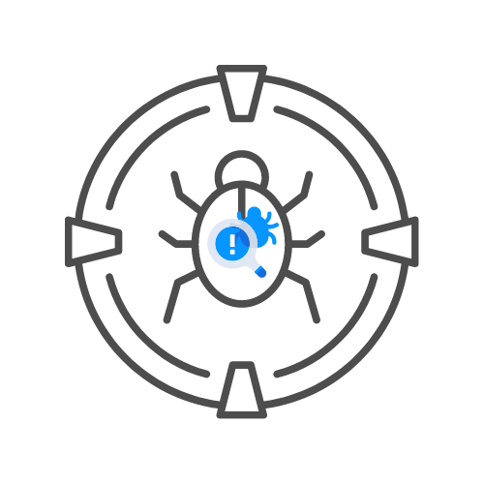
PTES - Intelligence gathering
DAY 02

Slide 2
Levels of gathering
Level 1
  Compliance driven
  Mainly automated
Level 2
  Best practice level
  Distilled from level 1
  Requires business understanding
Level 3

Slide 3
Levels of gathering
Level 1
Level 2
Level 3
  State sponsored level
  Much more advanced
  Distilled from level 1 and 2

Slide 4
Intelligence gathering
What is it?
  Perform recon
  Gather information
Why do it?
  Determine entry points
What is it not?
  May not be accurate or timely

Slide 5
Target selection
We need to name and identify our targets
  Identify all auxiliary TLDs and branches
Consider target limitations
Consider the length of a test
Consider the end goal of a test

Slide 6
OSINT
Passive information gathering
Semi-passive information gathering
Active information gathering

Slide 7
OSINT on corp level
Physical
  Locations (L1)
  Perseverance (L1)
  Relationships (L1)
Logical (L1-3)

Slide 8
OSINT on corp level
Electronic (L1-2)
Infrastructure assets (L1-2)
Financial (L1-3)

Slide 9
OSINT on Individual level
Look for employees
  History
  Social networks
  Internet presence
  Physical info
  Mobile footprints
  “For pay” Services

Slide 10
Covert gathering
On-site
Off-site

Slide 11
Footprinting
External footprints
  Passive (WHOIS lookup for example)
  Active (Port scan for example)
Internal footprints
  Passive (Packet sniffing)
  Active (VoIP monitoring)

Slide 12
Identify protection mechanisms
Network based
Host based
App. level
Storage level
User protections

