Slide 1
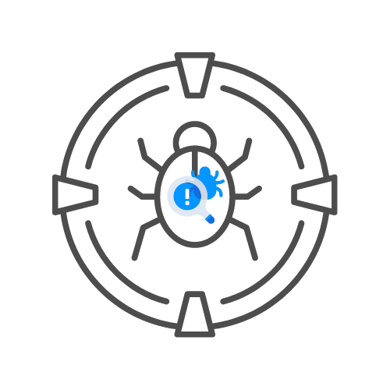
PTES - Pré-engagement
DAY 01 / INTRO

Slide 2
Scope
If not well-defined
  Scope creep is an issue
  Legal trouble
  Unsatisfied customers

Slide 3
Time estimation
Largely experience based
When done, add 20% buffer
If buffer not needed, simply do not bill
Define an end date

Slide 4
Scoping meeting
Takes place after contract signing
Discussion of what will be tested
Verify assumptions made during HLE
Determine geographic laws

Slide 5
Additional hourly charge
Scope creep should be charged
Ad hoc additions might
  Be documented poorly
  Contain an incomplete risk analysis
  Might not be analyzed legally

Slide 6
Questionares
A list of questions that should be asked
  See addition documentation in course

Slide 7
Scope creep
How to react when it happens?
Requests for additional work is a compliment
  Don’t be afraid to ask for compensation beforehand
  Treat existing customers well
    Give them a discount
    Value long term relationships

Slide 8
Specify start and end date
Validate timeframe before attacking
The work is not paid for until it is done!
  This includes retests
Add simple timeboxes to restesting

Slide 9
Third parties
Cloud providers
ISPs
MSSps
Country laws

Slide 10
Social engineering pretexts
Determine what is allowed
Sex, Drugs and rock & work best for social engineering
Might not be appropriate

Slide 11
DOS testing
Make sure you are allowed to test for DoS attacks

Slide 12
Payment terms
By default, payment follows 30 days after report delivery
Usually a % fine per month not paid
Recurring payments are an option
  Usually long term engagements
A deposit might be agreed upon
  Up to 50% of bill

Slide 13
Goals
Primary
  Always organisation focussed
Secondary
  Compliance focussed
Business goals

Slide 14
Lines of communication
Emergency contact info
All pentesters
Test managers
2 tech contacts at the client and every sub-organisation
Upper management or a business contact

Slide 15
Incident reporting
Think of incident response as well
Define an incident
  “a violation or imminent threat of violation of computer security policies, acceptable use policies, or standard security practices.”
  According to NIST

Slide 16
Status reporting
Frequency and manner of reporting
Based on length of engagement usually
Very important, do not chronically postpone
Skipping is very unprofessional

Slide 17
Secure communications
Use PGP
Add passwords to files or put in AEG encrypted ZIP
Secure mailboxes
Don’t text, call
Face-2-Face preferred

Slide 18
Rules of engagement
Define HOW to hack instead of WHAT
Timeline
Locations
Evidence handling
Status meetings

Slide 19
Rules of engagement
Time of day of testing
Permissions to test
Legal considerations

