Slide 1

Introduction to Bash Shell/Scripting
Ansh Bhawnani

Slide 2
What is Bash?
Bash is a Unix shell and command language written by Brian Fox for the GNU Project as a free software replacement for the Bourne shell
A shell program is typically an executable binary that takes commands that you type
Typically runs in a text window where user can interpret commands to carry out various actions.
Most modern Linux and Unix distributions provide a Bash shell by default.

Slide 3
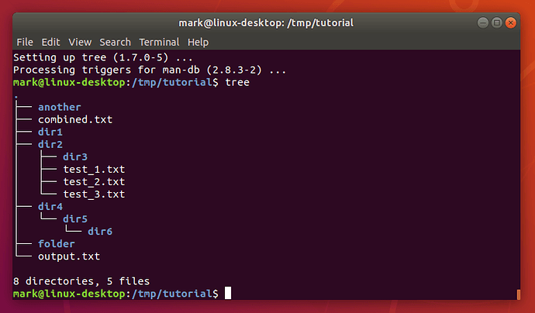
What is Bash?

Slide 4
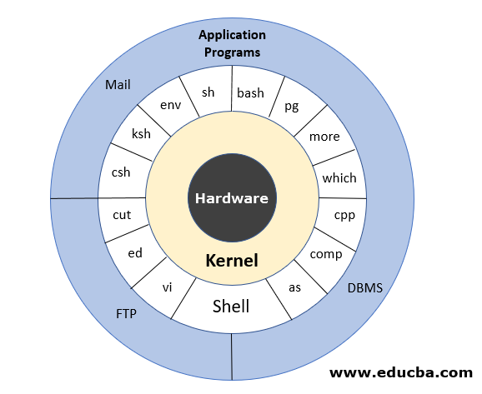
What is Bash?

Slide 5
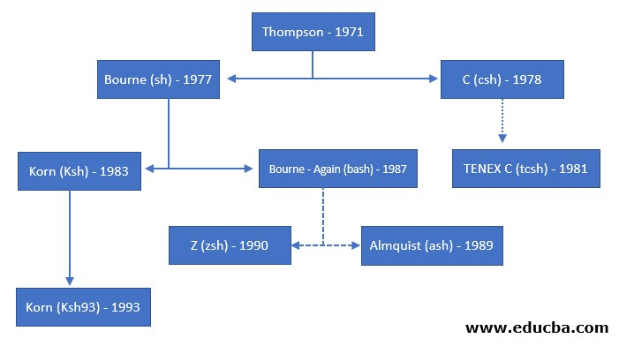
What is Bash?
History of Bash

Slide 6
Terminal vs Shell?
Terminal
  A piece of equipment through which you could interact with a computer
  Today's terminals are software representations of the old physical terminals, often running on a GUI
  Mainly helps in transmission of commands

Slide 7
Terminal vs Shell?
Shell
  Command interpreter whose main purpose is to run other programs
  Converts the command Into a kernel-understandable form and passes it to the kernel.
  Terminal passes the typed commands to shell, which understands them and tells the kernel what to do.

Slide 8
What is Bash
Features of Bash
  Bash is sh-compatible. It is incorporated with the best and useful features of the Korn and C shell like directory manipulation, job control, aliases, etc.
  Bash can be invoked by single-character command line options (-a, -b, -c, -i, -l, -r, etc. ) as well as by multi-character command line options also like --debugger, --help, --login, etc.
  Bash Start-up files are the scripts that Bash reads and executes when it starts. Each file has its specific use, and the collection of these files is used to help create an environment.
  Bash consists of Key bindings by which one can set up customized editing key sequences.

Slide 9
What is Bash
Features of Bash
  Bash contains one-dimensional arrays using which you can easily reference and manipulate the lists of data.
  Bash comprised of Control Structures like the select construct that specially used for menu generation.
  Directory Stack in Bash specifies the history of recently-visited directories within a list. Example: pushd builtin is used to add the directory to the stack, popd is to remove directory from the stack and dirs builtin is to display content of the directory stack.
  Bash also comprised of restricted mode for the environment security. A shell gets restricted if bash starts with name rbash, or the bash --restricted, or bash -r option passed at invocation.

Slide 10
What is Bash
Prerequisites
  Basics of Linux/Unix environment!
  Basics of terminal
  Basic shell commands

Slide 11
Terminal vs Shell?

Slide 12
THANKS!
Any questions?

