Slide 1
API hooking using the detours library
Intercepting API function calls

Slide 2
What is API hooking?
To add functionality into a program where the source code is not available
Make modifications at runtime without modifying the binary
In game cheats, api hooking can intercept function which checks for player health and return 100% health
Debuggers also use API hooking when you set breakpoints

Slide 3
What is Detours?
A library for extending Win32 functions
Intercepts Win32 functions by re-writing target function images
Includes utilities to attach arbitrary DLLs and payloads to any Win32 binary

Slide 4
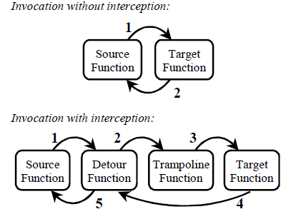
Calling function with and without interception
Source: Detours: Binary Interception of Win32 Functions, Galen Hunt and Doug Brubacher

Slide 5
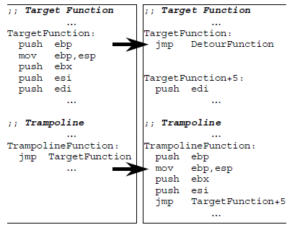
Target and Trampoline Functions, before and after hooking
Before hooking
After hooking
Source: Detours: Binary Interception of Win32 Functions, Galen Hunt and Doug Brubacher

Slide 6
Thank you

