Slide 1

Ediciones, precios y licenciamiento

Slide 2
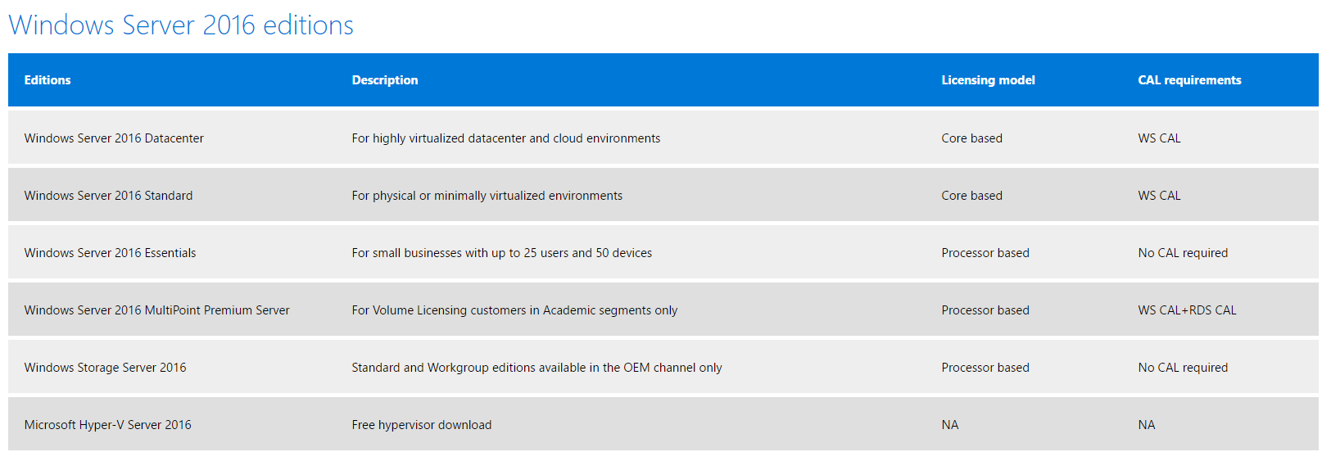
Ediciones

Slide 3
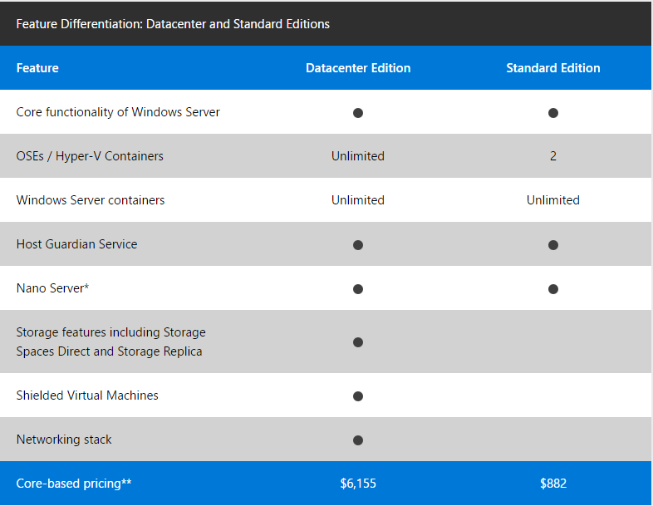
Precios y licenciamiento

Slide 4
 | Windows Server 2012 / 2012 R2 Standard & Datacenter | Windows Server 2016 Standard & Datacenter
Physical (Host) Memory Support | Up to 4 TB per physical server | Up to 24 TB per physiocal server (6x)
Physical (Host) Logical Processor Support | Up to 320 LPs | Up to 512 LPs
Virtual Machine Memory Support | Up to 1 TB per VM | Up to 16 TB per VM (16x)
Virtual Machine Virtual Procesor Support | Up to 64 VPs per VM | Up to 240 VPs per VM (3.75x)

Slide 5
 | Windows Server 2012 / 2012 R2 Standard & Datacenter | Windows Server 2016 Standard & Datacenter | VMware vSphere 6 Enterprise Plus
Physical (Host) Memory Support | Up to 4 TB per physical server | Up to 24 TB per physiocal server (6x) | Up to 6 TB per physical server
Physical (Host) Logical Processor Support | Up to 320 LPs | Up to 512 LPs | Up to 480 LPs
Virtual Machine Memory Support | Up to 1 TB per VM | Up to 16 TB per VM (16x) | Up to 4 TB per VM
Virtual Machine Virtual Procesor Support | Up to 64 VPs per VM | Up to 240 VPs per VM (3.75x) | Up to 64 VPs per VM

Slide 6
