Slide 1
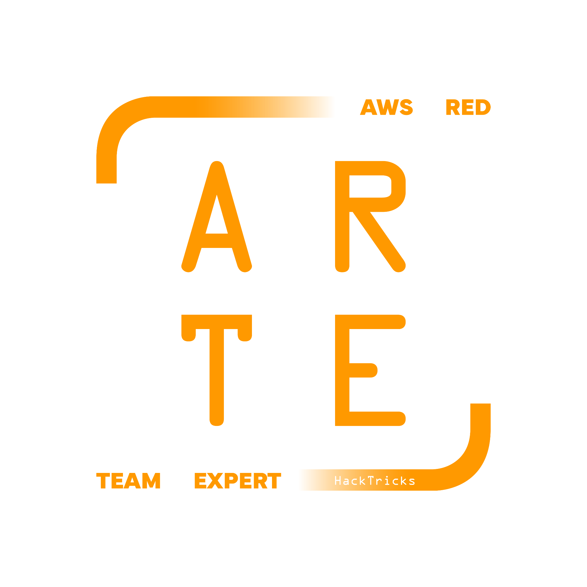
SQS
Simple Queue Service
HackTricks Training
https://t.me/CyberFreeCourses

Slide 2
Basic Information
Amazon Simple Queue Service (SQS) is a fully managed message queuing service that enables you to decouple and scale microservices, distributed systems, and serverless applications. SQS eliminates the complexity and overhead associated with managing and operating message-oriented middleware, and empowers developers to focus on differentiating work.
Sensitive information could be found in these queues or even data could be injected in them to exploit a vulnerability in a service listening for messages in the queue.
https://t.me/CyberFreeCourses
https://cloud.hacktricks.xyz/pentesting-cloud/aws-security/aws-services/aws-sqs-enum

Slide 3
Manual Enumeration
# Get queues info
aws sqs list-queues
aws sqs get-queue-attributes --queue-url <url> --attribute-names All
# More about this in privesc & post-exploitation
aws sqs receive-message --queue-url <value>
aws sqs send-message --queue-url <value> --message-body <value>
https://t.me/CyberFreeCourses
https://cloud.hacktricks.xyz/pentesting-cloud/aws-security/aws-services/aws-sqs-enum

Slide 4
Privilege Escalation
DEMO
sqs:AddPermission
  Grant extra permissions over the queues.
sqs:SendMessage, sqs:SendMessageBatch
  Inject messages in a queue
sqs:ReceiveMessage
  Get sensitive information from a message
https://t.me/CyberFreeCourses
https://cloud.hacktricks.xyz/pentesting-cloud/aws-security/aws-privilege-escalation/aws-sqs-privesc
Notes:
Send and listen for a message

Slide 5
Post Exploitation
sqs:DeleteMessage,sqs:ChangeMessageVisibility
  Remove messages
sqs:DeleteQueue
  Delete queue
sqs:PurgeQueue
  Remove messages from a queue
sqs:SetQueueAttributes
  Affect performance, security, or availability.security, or availability.
sqs:RemovePermission
  Remove permissions of principal
https://t.me/CyberFreeCourses
https://cloud.hacktricks.xyz/pentesting-cloud/aws-security/aws-post-exploitation/aws-sqs-post-exploitation

Slide 6
Persistence
{
"Version": "2008-10-17",
"Id": "__default_policy_ID",
"Statement": [
{
"Sid": "__owner_statement",
"Effect": "Allow",
"Principal": {
"AWS": "*"
},
"Action": [
"SQS:*"
],
"Resource": "arn:aws:sqs:us-east-1:123123123123:MyTestQueue"
}
]
}
https://t.me/CyberFreeCourses
https://cloud.hacktricks.xyz/pentesting-cloud/aws-security/aws-post-exploitation/aws-sqs-post-exploitation

