Slide 1
SD-WAN
c
Khawar butt
CCIE # 12353 [R/S, Security, SP, DC, Voice, Storage, Wireless]
CCDE#20110020

Slide 2
Overview
c
SD-WAN Overview
Initializing Controllers
Initializing vEdges & cEdges
Configuring Templates
Configuring a Service VPN using Templates
Configuring Centralized Policies
Advanced Configurations

Slide 3
Software Defined – WAN (SD-WAN)
c
Software Defined WAN is a technology based on SDN approach to centrally provision, manage, monitor, report and troubleshoot your WAN network. The main benefits are:
Operational Cost Reduction
Enable Performance based Traffic Engineering across multiple transports in your WAN
Provides Security using built-in IPSec capabilities
Traffic Analysis and simulation tools
Easy change of topologies

Slide 4
SD–WAN Components
c

Slide 5
SD–WAN Controllers Devices
c
Management Plane
vManage
Single Management Pane
Centralized provisioning
Central Policies and Templates
Centralized Troubleshooting and Monitoring
Software upgrades

Slide 6
SD–WAN Controllers Devices
c
Control Plane
vSmart
vSmart distributes control plane information to the WAN Edges using OMP
All the Policies for Data flow are defined centrally on vManage and distributed to WAN Edges using vSmart

Slide 7
SD–WAN Controllers Devices
c
Orchestration Plane
vBond
Authentication Device
It is responsible for distributing list of vSmarts & vManage reachability to all WAN Edge routers
It requires IP reachability

Slide 8
Controller Hosting Options
c
Cloud Hosted
Amazon AWS
Microsoft Azure
Google Cloud Platform
Cisco Controller as a Service
On-Premises
ESXi
KVM

Slide 9
SD–WAN WAN Edge Devices
c
Data Plane
vEdge/cEdge
The WAN Edge Device Communicates to vSmart controllers using OMP to setup the Data Flow
Implements data plane routing policies
Available as a Physical or Virtual device

Slide 10
SD–WAN WAN Edge Devices
c
vEdge/cEdge
ISR Routers
ASR Routers
ENCS 5XXX
CSR Routers VMs
vEdge Devices (Physical/VMs)

Slide 11
SD-WAN Technologies –
Infrastructure & VPNs
c
Controllers have 2 VPNs by default, VPN 0 & VPN 512
VPN are like VRFs
VPN 512 is the Out-of-Band Management VPN
VPN 0 is the Transport / Control VPN

Slide 12
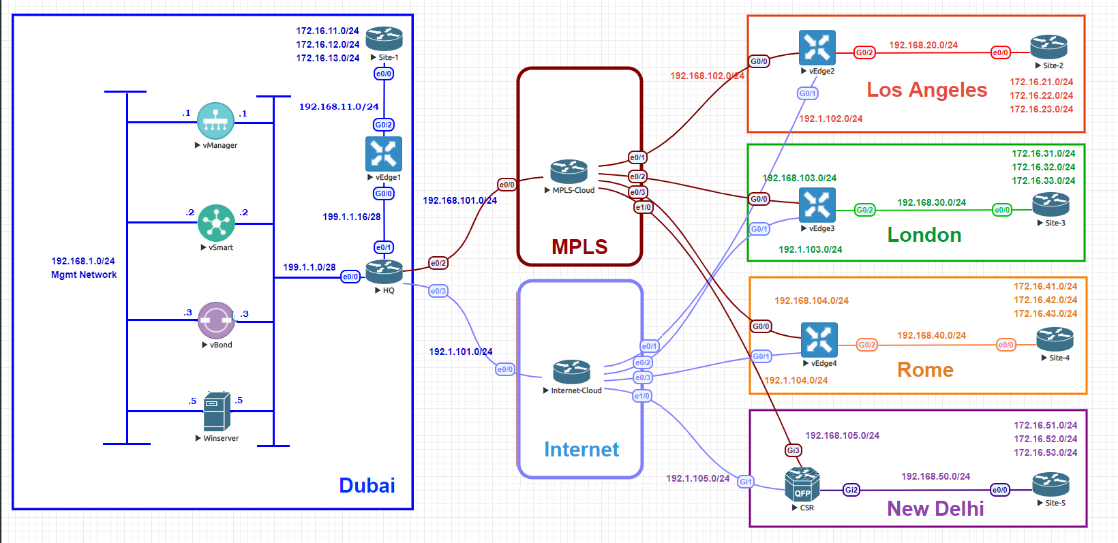
SD-WAN Technologies –
Service VPNs
c

Slide 13
SD-WAN Technologies –
Service VPNs
c
Service VPNs are Data VPNs
They connect the branch offices to the Headquarters, Data Centers and Cloud Services
Service VPNs are VPNs between VPN 1 – 65535 – (minus 0 & 512)

Slide 14
SD-WAN Technologies –
Overlay Management Protocol (OMP)
c
OMP is the control protocol used to communicate between the controllers and the WAN Edge devices
It is responsible for distributing reachability information, control policies and security policies in the WAN

Slide 15
SD-WAN Technologies –
Organization
c
Identifier that is common to all the devices in the SD-WAN setup
Configured on each device

Slide 16
SD-WAN Technologies –
Site ID
c
Site ID is a numerical Identifier that allows SD-WAN to group devices to each other
It is used in policies to classify characteristics associated with a location

Slide 17
SD-WAN Technologies –
System IP
c
System IP is a like a Router-ID
It uniquely identifies each device (Controllers and WAN Edges)
Although it is the form of an IP, it is only used to Identity devices
It is one of the components in the Transport Locator (TLOC)

Slide 18
SD-WAN Technologies –
Color
c
It allows you to identity transport tunnels
It is more like a Tag
For example, if your router has 2 WAN transports, Interet Connection and a MPLS Connection, you need to classify them by using a color.
It is one of the components in the Transport Locator (TLOC)

Slide 19
SD-WAN Technologies –
Transport Locator (TLOC)
c
It is an identifier that is used as the Next-Hop in a OMP Route
It is made up of 3 components:
  System IP of the device
  The Tunnel Color
  Encapsulation (IPSec or GRE, generally IPSec)

Slide 20
Initializing the Controllers
Transport Locator (TLOC)
c
It is an identifier that is used as the Next-Hop in a OMP Route
It is made up of 3 components:
  System IP of the device
  The Tunnel Color
  Encapsulation (IPSec or GRE, generally IPSec)

Slide 21
Whiteboard
c

