Slide 1
Intro to Registers

Slide 2
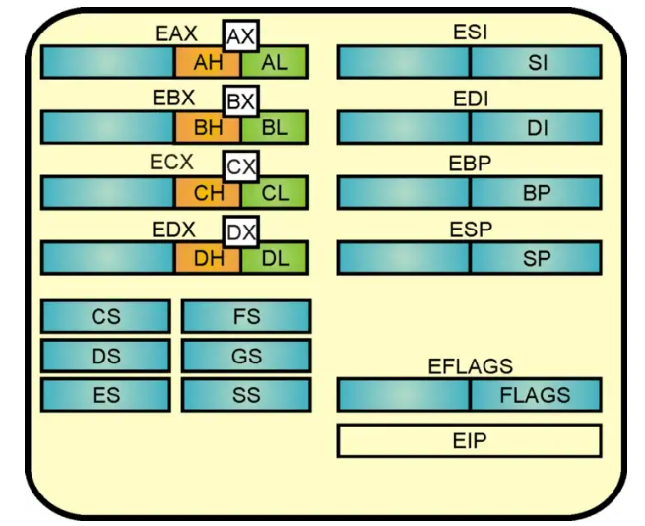
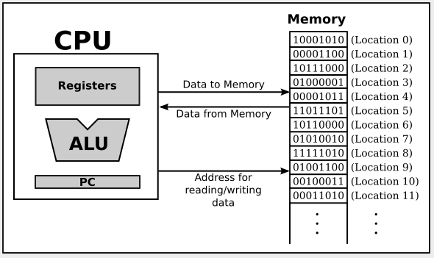

Slide 3
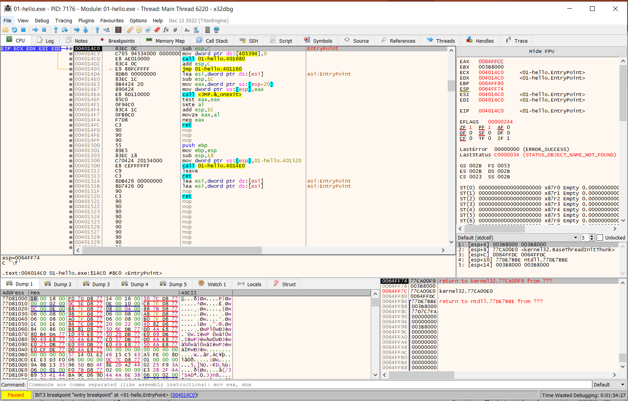

Slide 4
Basic general purpose registers
EAX
EBX
ECX
EDX

Slide 5
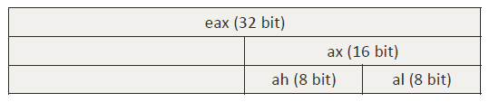
Internal structure of each register (32-bit)
EAX is dword which is 4 bytes (32 bits)
AX is a word which is 2 bytes (16 bits)
AH is a byte (8 bits)
AL is also a byte (8 bits)
If EAX = 0x12345678
AX = 5678
AH = 56
AL = 78

Slide 6
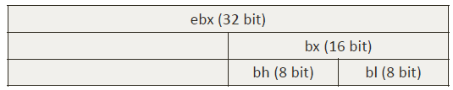
Same for EBX, ECX, EDX
For EBX,
If EBX = 0x12345678
BX = 5678
BH = 56
BL = 78

Slide 7
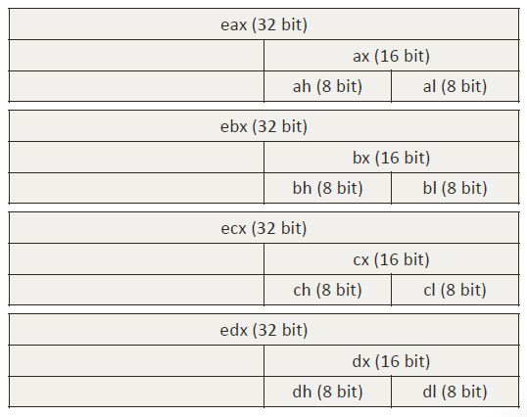

Slide 8
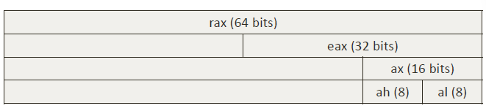
64-bit registers
RAX is qword which is 8 bytes (64 bits)
EAX is a dword which is 4 bytes (32 bits)
AX is word which is 2 bytes (16 bits)
AH is a byte (8 bits)
AL is also a byte (8 bits)

Slide 9



ESI, EDI, EIP, ESP, EBP registers
String index registers:
ESI = Source Index
EDI = Destination Index
Instruction pointer:
EIP indicates the memory current address of current instruction
Stack Frame Pointers:
ESP = address of top of stack
EBP = address of bottom of stack

Slide 10
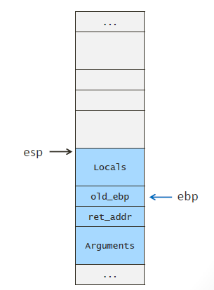

Slide 11
Thank you

