Slide 1
NEG Instruction

Slide 2
NEG means to negate
eg:
neg al
It changes the sign of the number using two’s complement method
i.e. flips all bits and then adds 1 to the number

Slide 3
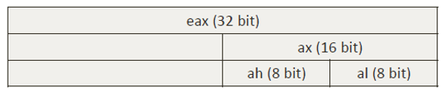
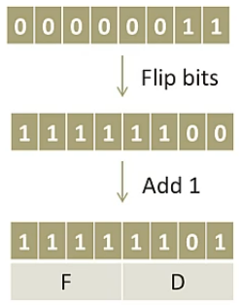
Example
mov al, 0x3
neg al

Slide 4
Practical example
mov eax, 0x1
neg eax
neg eax

